Slide 1
Collection data types in Python: How to decide which one to use
Tihomir Kamenov
06 Feb 2024

Slide 2


Slide 3
Agenda
Introduction: what is a collection?
Advanced dive in Python built-in Collections - methods and examples for:
List
Tuple
Dictionary
Set
Algorithm complexity and Big O Notations
How collections fit in fundamental Data Structures
Conclusion: which one to use for your specific needs

Slide 4
What is a Collection ?
Container for multiple items of data
Mutable
Data can be changed
Immutable
Data can’t be changed

Slide 5
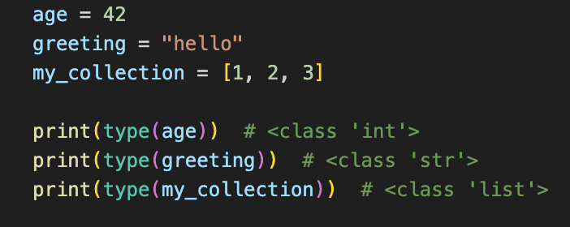
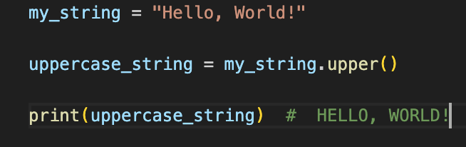
What is an Object ?
Data Structure that contains attributes (or properties) and methods (functions associated with this data)
Defining variables…
…then methods can be applied
…Python turning them into objects

Slide 6
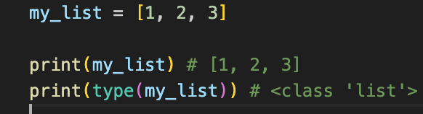
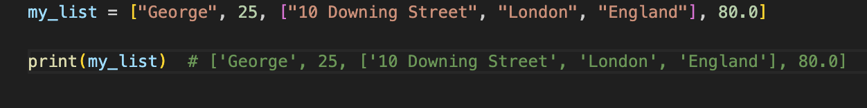
What is a List then ?
Built-in ordered, mutable collection in Python. It is a container for a different type of data
Defining list using square brackets
Can contain different type of data

Slide 7
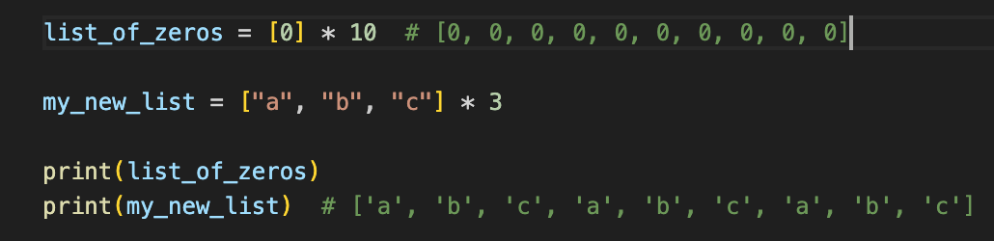
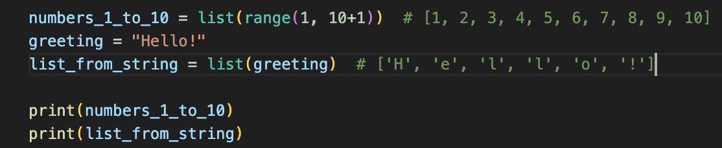
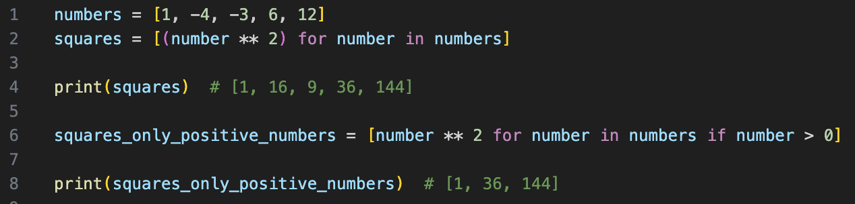
Defining a List in Python
…using multiplication
Few approaches for define a list, in Python…
…using built-in function list()
…using List Comprehension

Slide 8
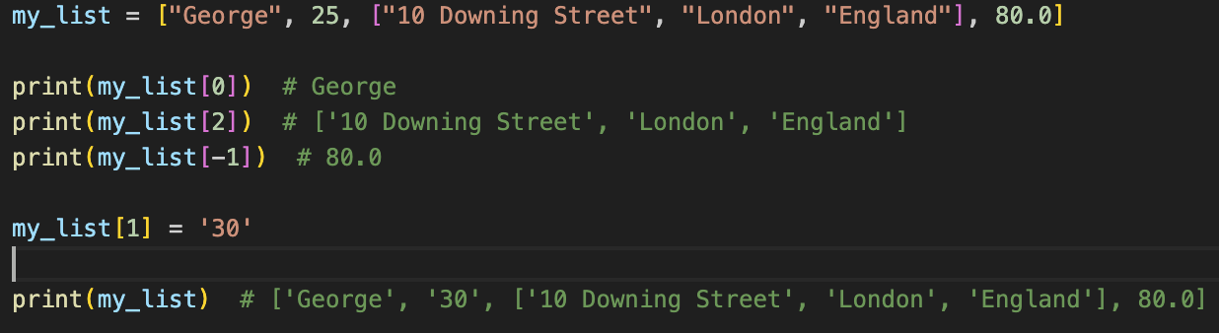
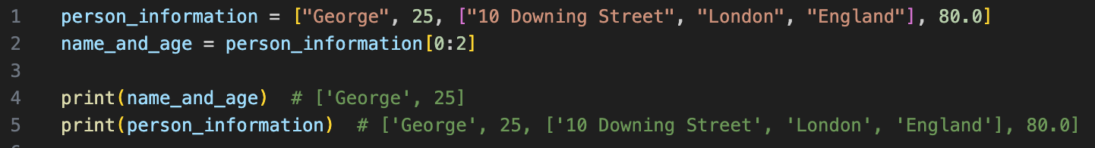
Accessing elements from a List
We can access one or more elements from a list using square brackets…
..and also, changing the value

Slide 9
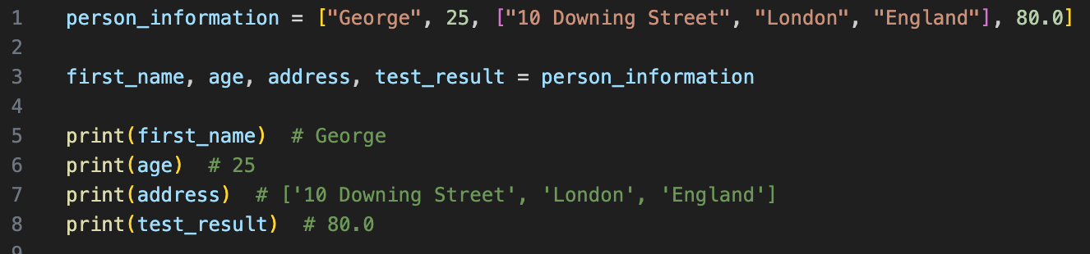
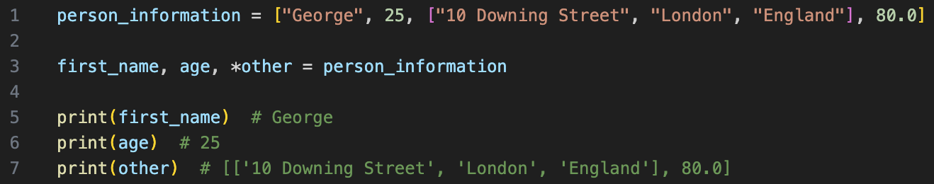
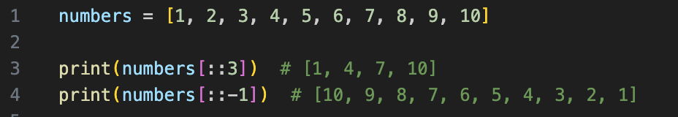
Python “syntax sugar”
Written code in a readable manner without changing functionality
Unpacking
Involves shortcuts or special syntax that simplifies common tasks.

Slide 10
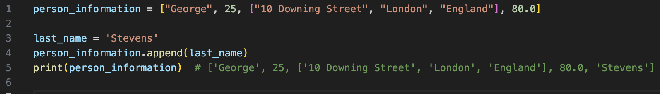
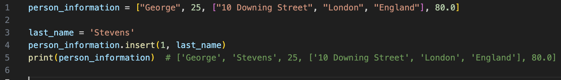
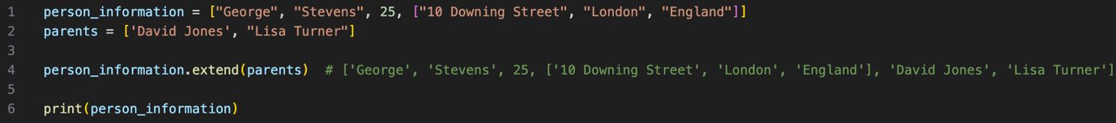
List Methods - adding elements
append() adds at the end of the list
insert() adds at the specific index
extend() adds a list at the end of the particular list

Slide 11
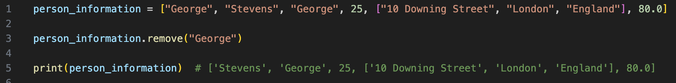
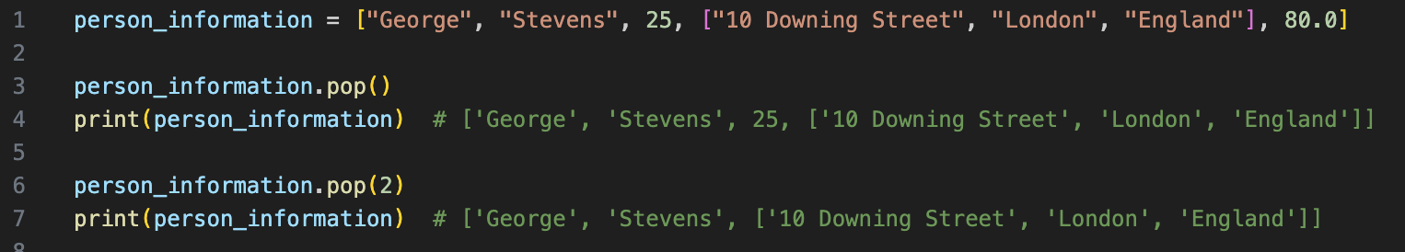
List Methods - remove elements
remove() method removes the first element found
pop() removes the element on a given index
clear() removes all of the elements in the list

Slide 12
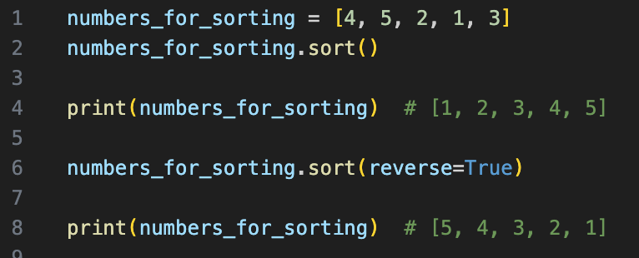
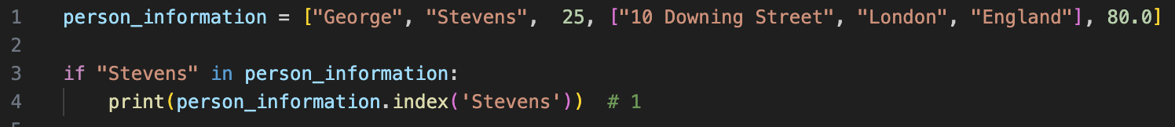
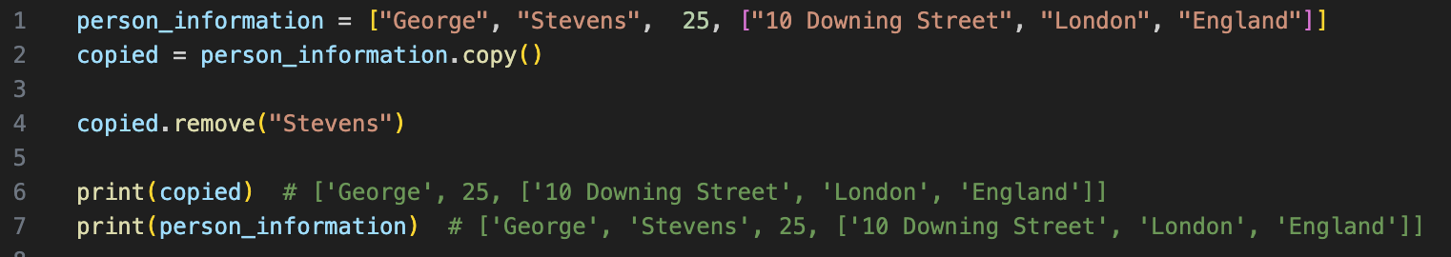
… more List Methods
count() returns number of occurrences
sort() method can also accept params
index() shows the location of given element
copy() method creates a copy of particular list

Slide 13
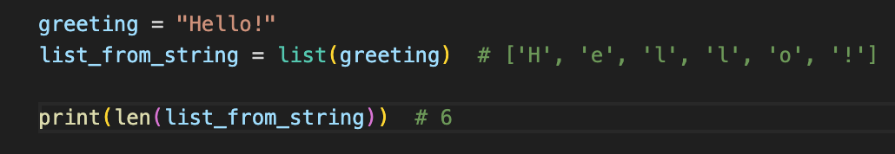
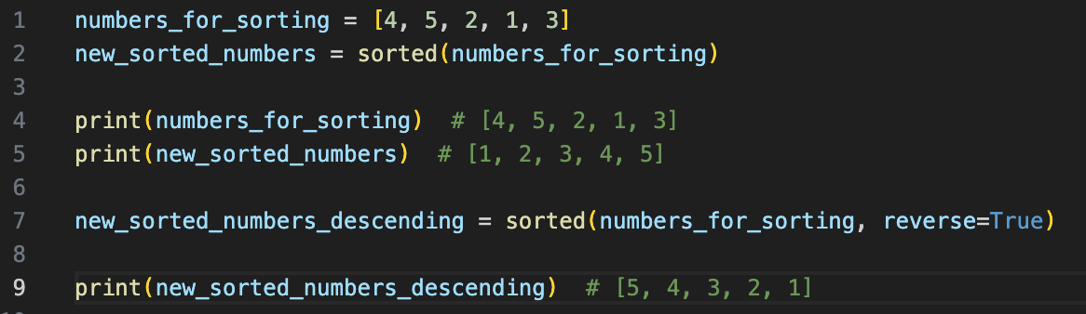
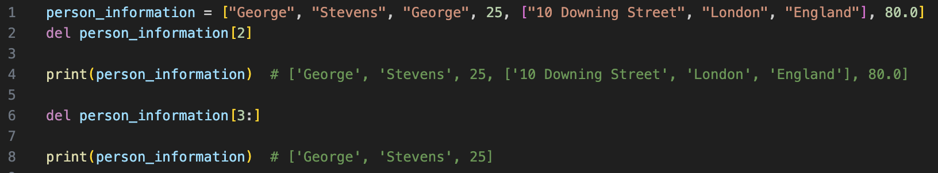
Built-in functions called on List
len() gives the total number of elements
sort() method can also accept params
del statement deletes the element on a given index or a range of elements

Slide 14
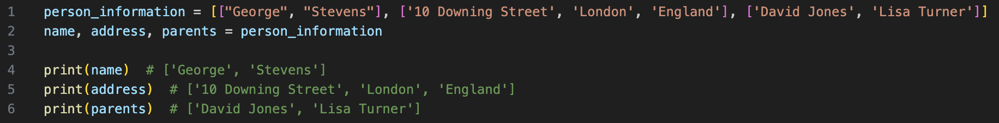
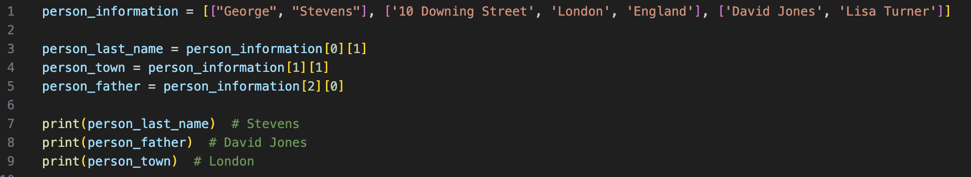
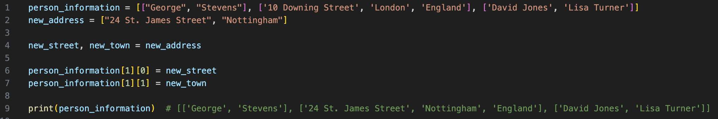
Multi-dimensional lists: Matrices
Matrix in Python is a list where, each element of this list is a list
First index shows the row of this matrix, second one is the column
Elements in the matrix can be changed

Slide 15
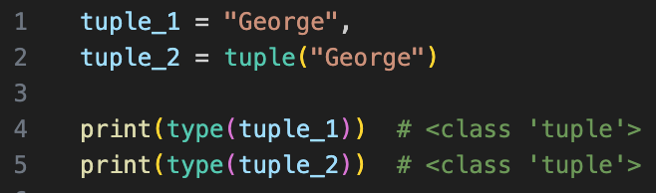
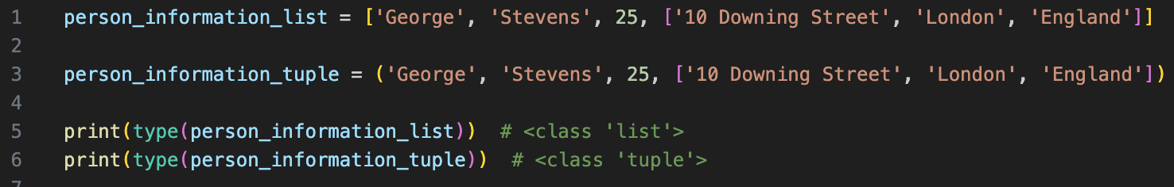
Tuples
Built-in ordered, immutable collection in Python. It can store any type of data
Defining tuple
Important ! Once created, modifying elements is not allowed

Slide 16
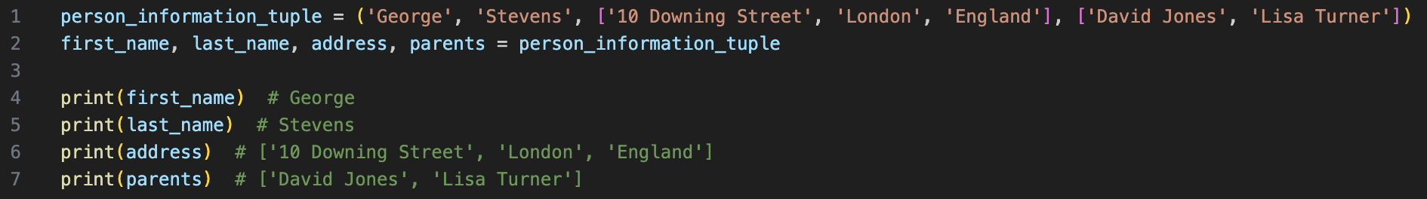
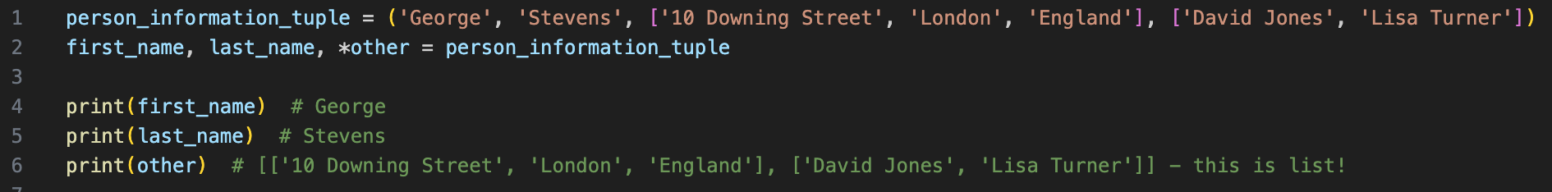
Can we unpack Tuple…
…yes, we can!
We can use an asterisk ( * ) to pack the data, we don’t need

Slide 17
Tuple Methods
count() returns number of occurrences
index() shows the location of given element

Slide 18
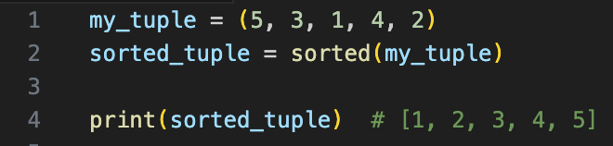
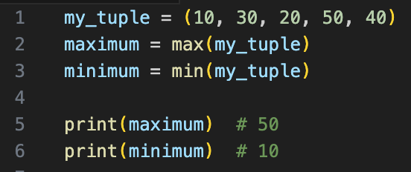
Functions called on Tuple
sorted() – for sorting
max() returns the highest value
min() returns the lowest value

Slide 19
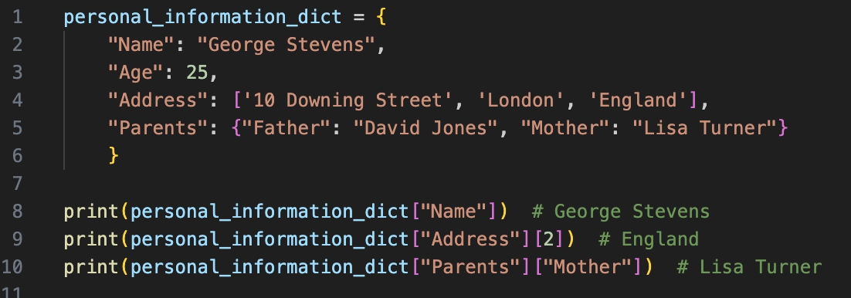
How to use Dictionaries ?
Built-in ordered (since Python 3.7 launched), mutable collection of key-value pairs, indexed by keys
Using square brackets, we can access the elements…

Slide 20
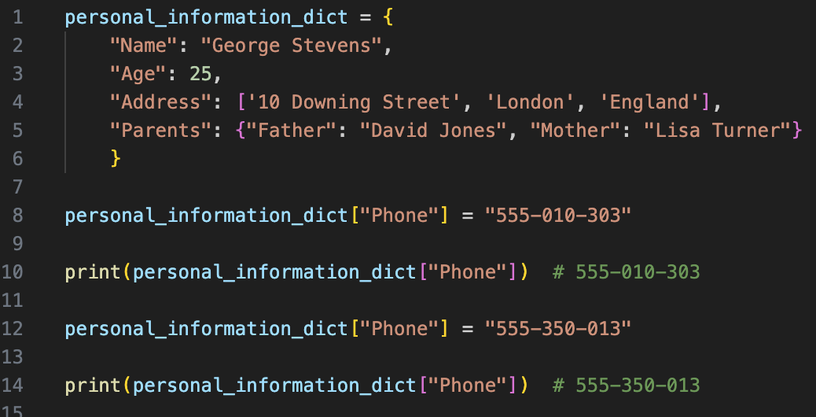
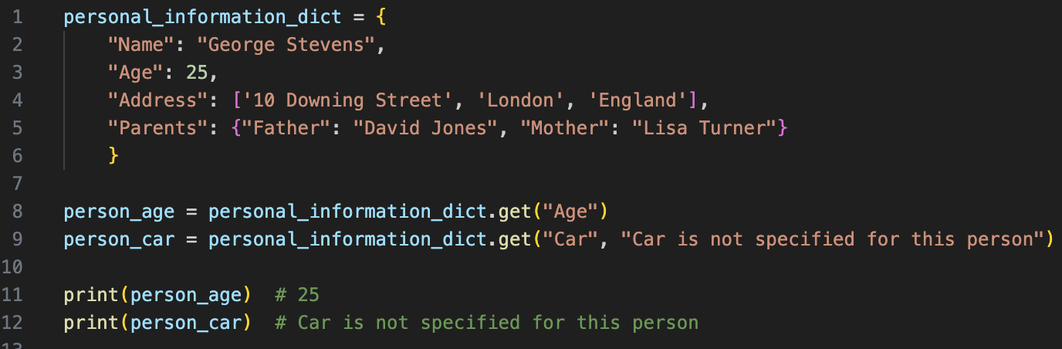
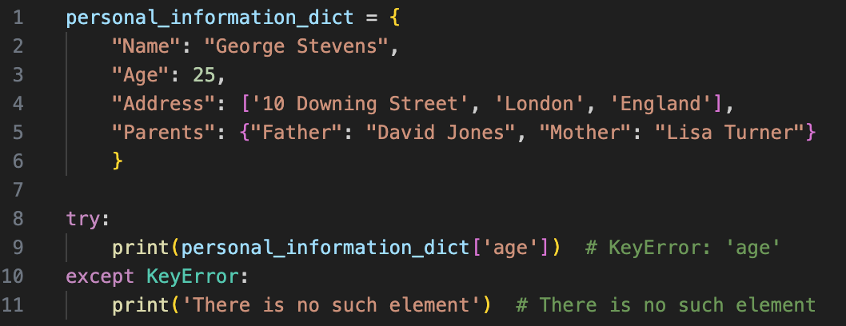
Important !
Using get() we can set a default value if the key is not present
We can add or update current value
If the key is not present, Python will raise KeyError

Slide 21
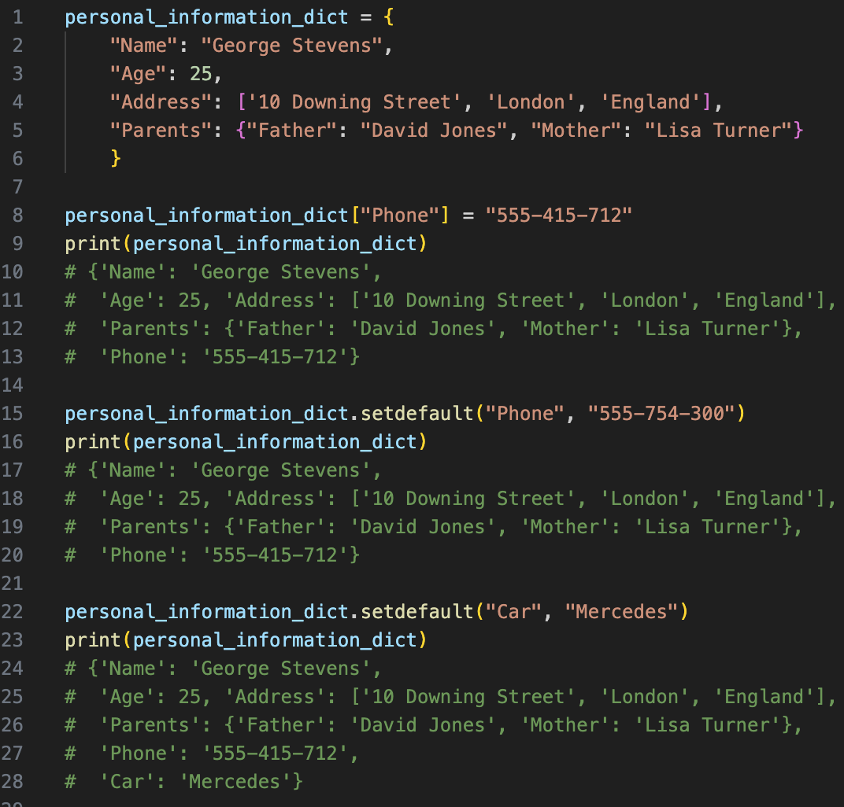
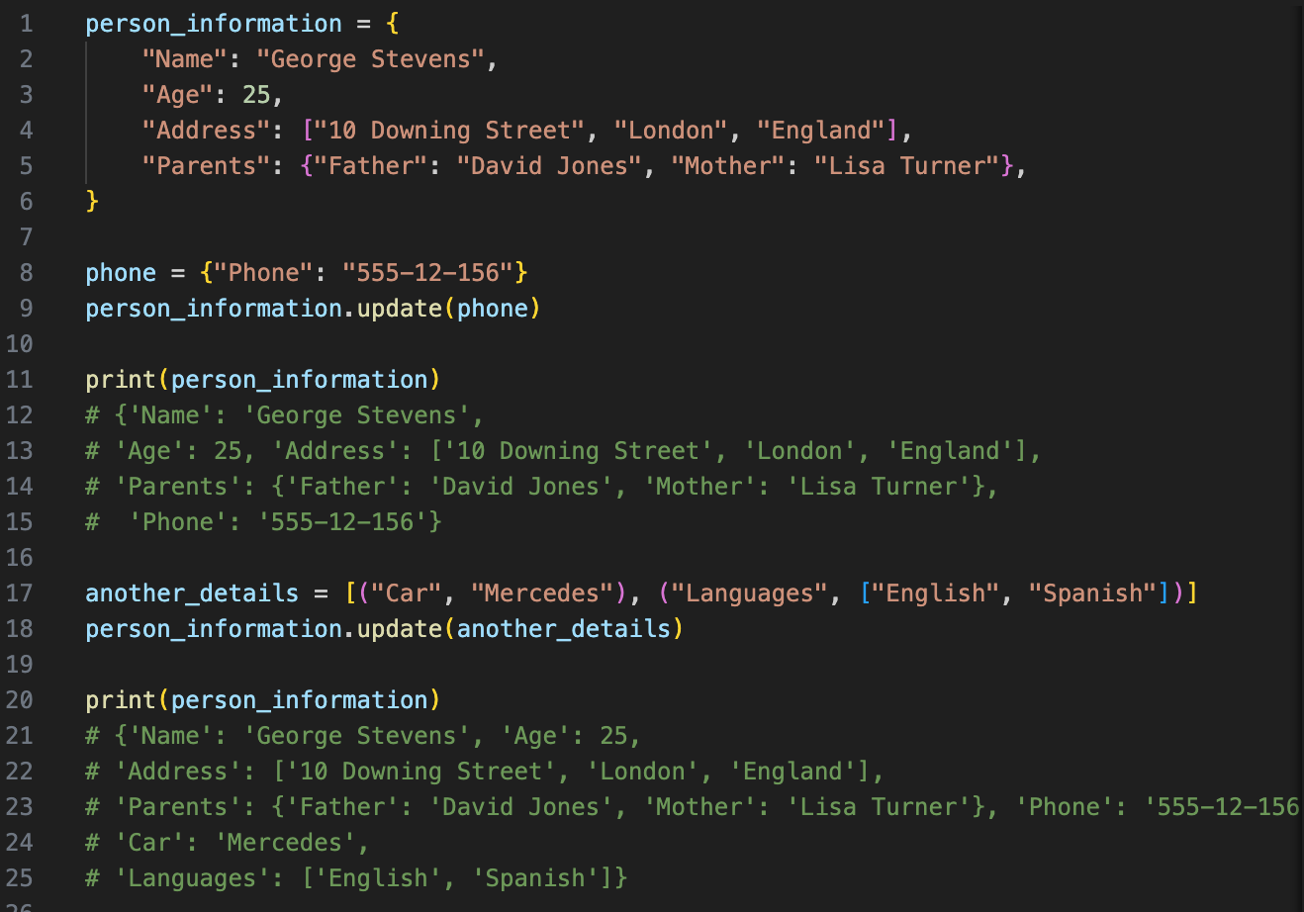
dict.methods() – add an element
If a key is not present, setdefault() will add it!
update() adds a new key-value pair

Slide 22
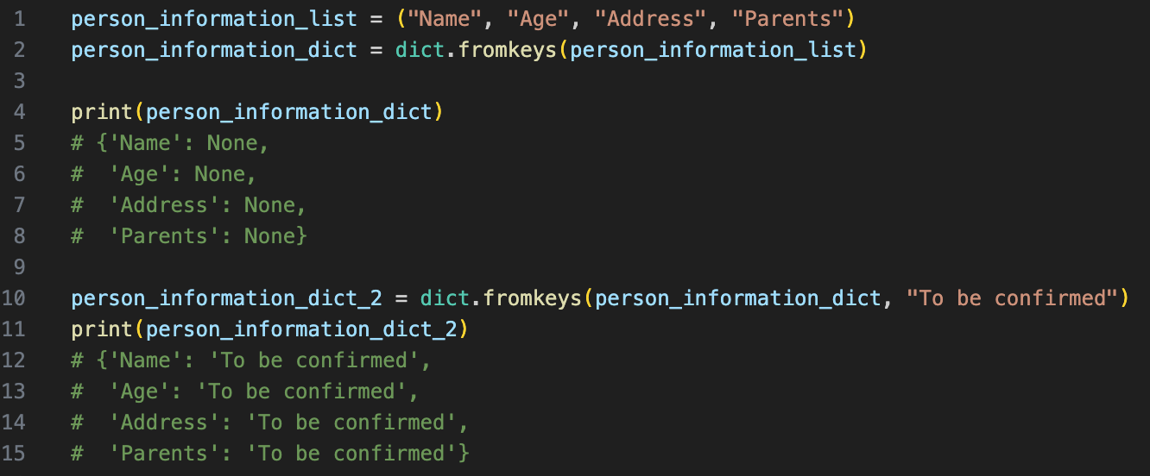
dict.methods() – add an element
fromkeys() creates dictionary from a given collection…
..also, can be used with default value

Slide 23
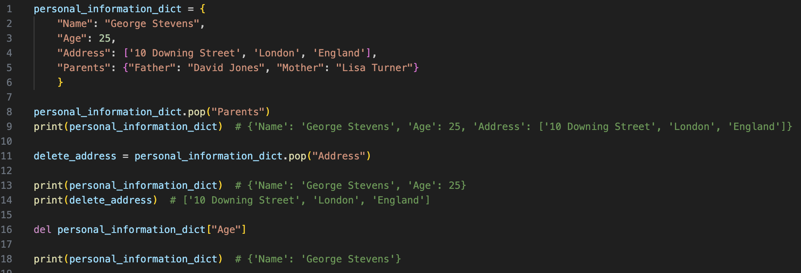
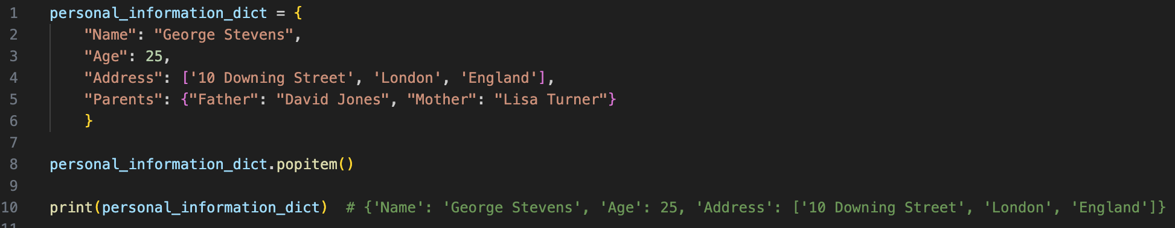
dict.methods() – remove an element
pop() allows access to the value when needed
del statement raises an error if the key is not present
popitem() removes the last element

Slide 24
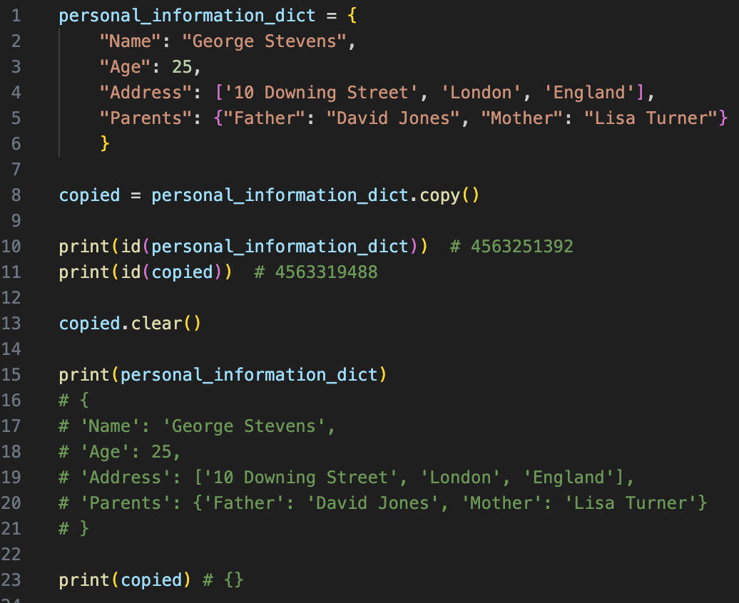
dict.methods() – remove an element
copy() creates a copy of particular dictionary
clear() removes all elements

Slide 25
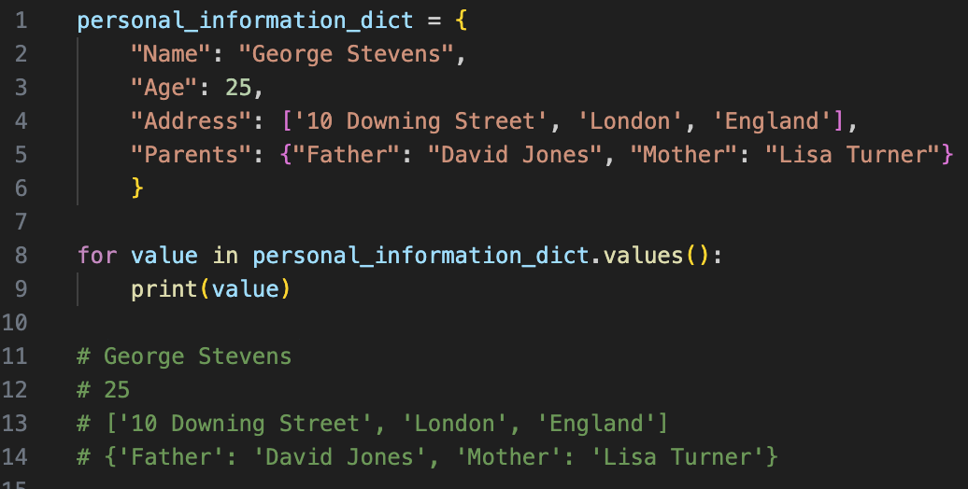
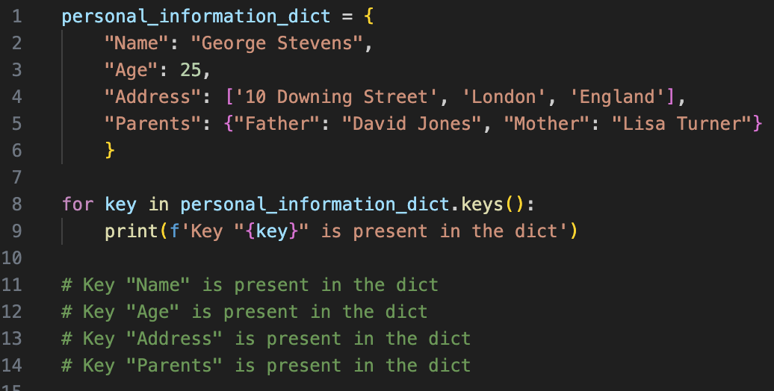
Iterating through a dict
All four built-in collections in Python can be iterated over using “for” loop and the “in” operator
values() returns all of the values
…and keys() returns all of the keys

Slide 26
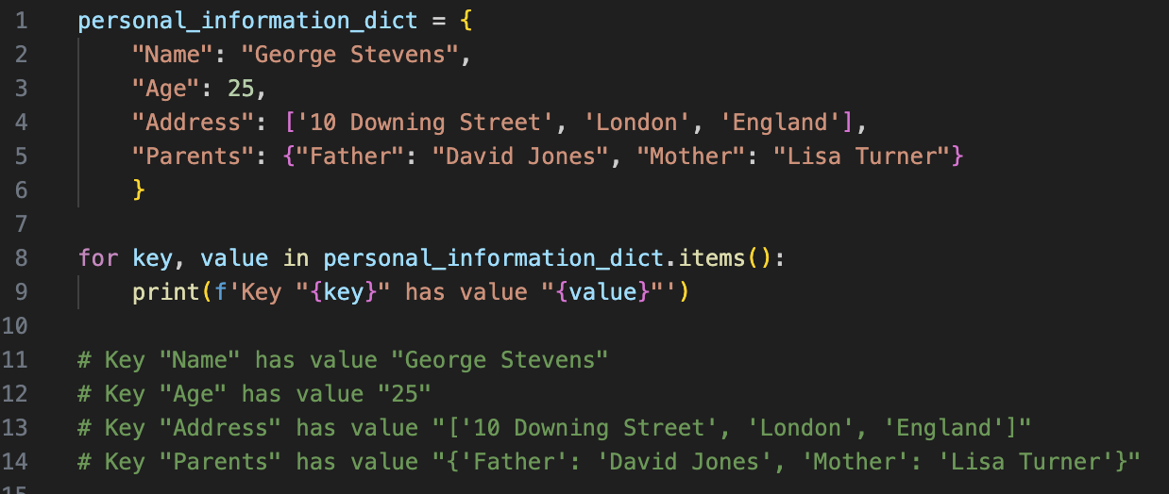
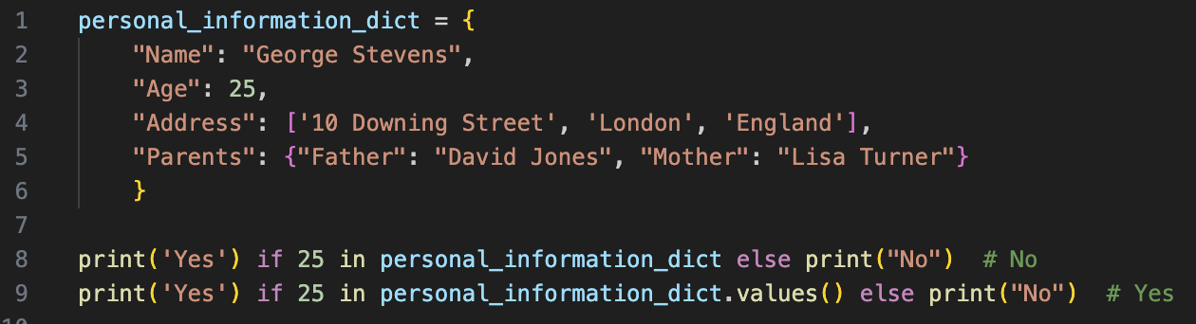
Iterating through a dict
items() returns both – keys and values
“in” operator works extremely fast!

Slide 27
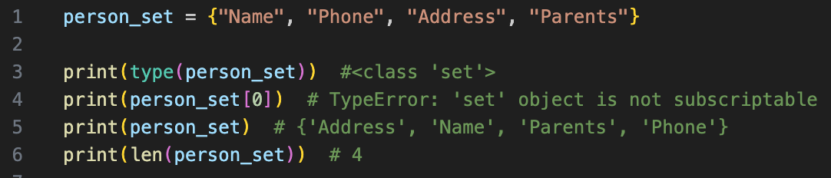
Last but not least - Set
Bult-in unordered, mutable collection of unique items
Python recognizes the collection as set
Indexing via square brackets will raise a TypeError
We can use len() to check the length of the set

Slide 28
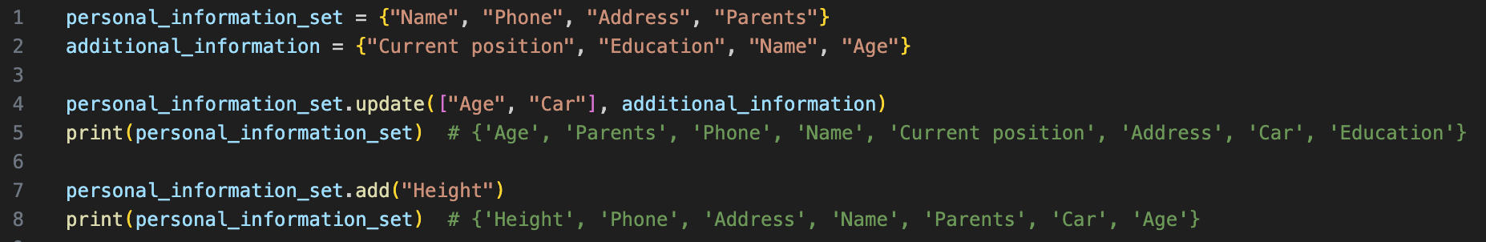
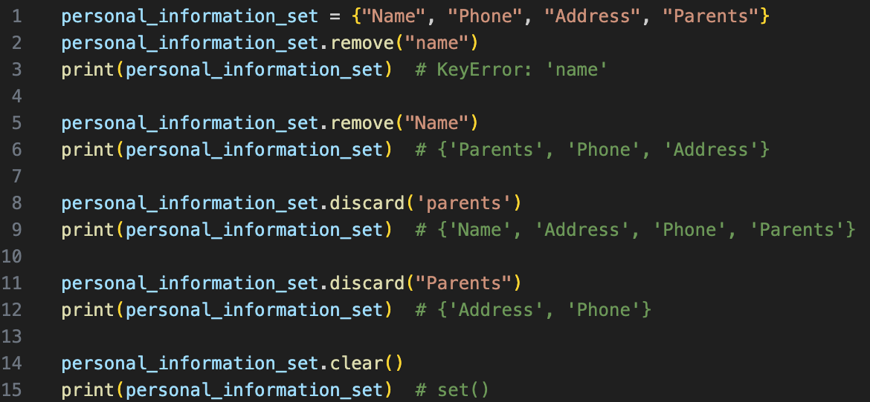
Let’s talk about set.methods()
update() adds new element / elements
add() adds a single element
remove() deletes a single element
discard() does not raise a KeyError
clear() removes all elements

Slide 29
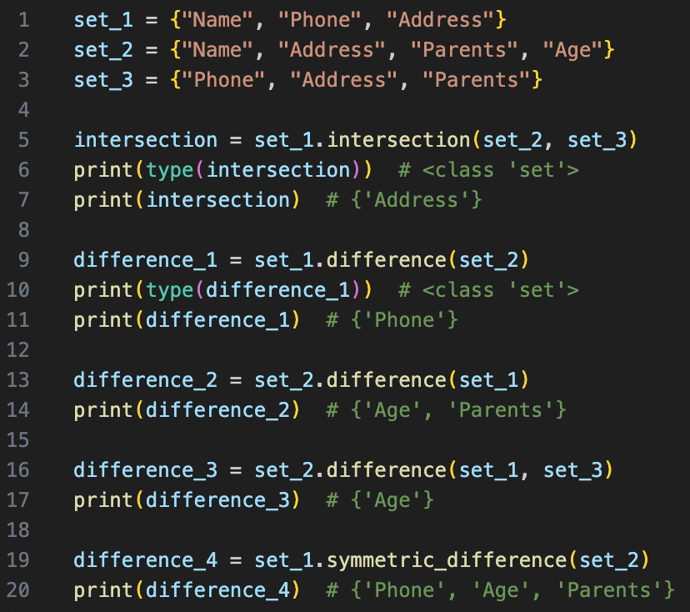
Few “different” methods
intersection() finds the common elements between two or more sets
difference() finds the elements that are present in one set but not in another
symetric_difference() finds the elements that are unique to each of the sets being compared

Slide 30



Few “different” methods
intersection_update() removes the items in the set that are not present in other, specified set(s)
difference_update() removes the items in the set that are also included in another set
symetric_difference_update() update a set by keeping only the elements that are present in either the original set or the specified set(s), but not in both

Slide 31
Algorithms
Set of well-defined instructions or rules designed to solve a specific problem or perform a particular task
03
01
02
Input Data
Precisely defined
Steps
Algorithm produces one or more Outputs

Slide 32
Algorithm Must !
Consistency - produce the same output for the same input
Optimality - should strive to achieve the best possible performance
Simplicity and Clarity – easy to understand, implement, and maintain
Adaptability – reusable in various contexts for both - different problem instances or changing requirements

Slide 33

Algorithm Complexity
Analysis of how an algorithm's performance scales with the size of its input, also known as time and space complexity
Measures how the runtime and memory requirements of an algorithm grow as the input size increases
Best Case
Average Case
Worst Case

Slide 34
Big-O notations
Mathematical notation used in computer science to describe the complexity (performance) of an algorithm in terms of its input size
Complexity
Notation
Description
Constant
O(1)
Does not depend on the input data size
(n = 1,000,000 -> const operations)
Logaritmic
O(log n)
Grows logarithmically with the size of the input
(n = 1,000,000,000 -> 30 operations)
Linear
O(n)
Grows linearly with the size of the input
(n = 10,000 -> 10,000 operations)
Quadratic
O(n^2)
Grows quadratically with the size of the input
(n = 500 -> 250,000 operations)
Cubic
O(n^3)
Grows cubically with the size of the input
(n = 200 -> 8,000,000 operations)
Exponential
O(2^n)
Grows exponentially with the size of the input
(n = 20 -> 1,048,576 operations)

Slide 35


Big-O notations
A for loop that iterates over a collection, typically has O(n) complexity
We typically focus on the dominant or highest-order term
Total number of operations are f(n) = 3n^2 + n

Slide 36
Fundamental Data Structures
Structures, that require abstract implementation based on the specific requirements of the application
Linear
Graphs
Trees
Hash Tables

Slide 37
Should be aware of those structures ?
Efficient Problem Solving
Scalability
Algorithm Design
Optimized Resource Usage
Foundation for Advanced Topics

Slide 38

Linear Data Structures - Arrays
Linear data structures that stores elements in contiguous memory locations
5
3
6
1
7
4
List elements
0
1
2
3
4
5
List indexes
3000
3004
3008
3012
3016
3018
Memory address
A list can be considered similar to an array
There is no direct access to array in Python!

Slide 39
Inserting an element in a list
Python interpreter allocates memory to accommodate the new element O(n) complexity
1
2
3
1
2
3
insert(2, 4)
append() method, has so-called amortized constant time complexity
4

Slide 40
Removing an element from a list
1
2
3
4
1
2
4
remove(3)
Python interpreter adjusts the memory allocation accordingly O(n) complexity

Slide 41
Linear Data Structures – Linked lists
Linear data structure where each element, called a node, is a separate object that contains a reference (or link) to the next node in the sequence
3
5
8
9
4
7
13
15
19
None
Array
Linked list
In double linked lists each node contains a data, a reference to the next node, and a reference to the previous node in the sequence.

Slide 42
Extremely fast - Hash Tables
Data structure used to store key-value pairs
Hashing the key and calculates a fixed-size integer
0
Value 2
Key 1
1
Hash
2
Key 2
3
Value 1
4
Hash tables provide constant time complexity O(1) for most operations under average conditions
Calculated integer is used as an index in the underlying array

Slide 43
Hash Table - Collisions
Collision occurs when the hash function calculates the same index for “Peter” and “David”
0
Chaining
Open Addressing
Peter
1
Robin Hood Hashing
Hash
2
Cocko Hashing
David
3
?
4
In Python, dictionaries and sets are implemented using hash tables

Slide 44
Conclusion – How to choose ?
The type of data you need to store: Is it ordered or unordered? Do you need to enforce uniqueness?
The operations you need to perform: Are you mainly reading, inserting, updating, or deleting elements?
The performance characteristics: Consider factors like time complexity for common operations and memory usage
Mutability requirements: Do you need a data structure that can be modified after creation, or is immutability preferable?
The Built-in methods and features: Each data structure in Python comes with its own set of built-in methods and features. Consider whether these align with your requirements.

Slide 45
—Linus Torvalds-
“Bad programmers worry about the code. Good programmers worry about data structures and their relationships”

Slide 46
THANK YOU !
Do you have any questions?
kamenov.tihomir@gmail.com
+ 359 877 556 577

Slide 47
References
Time-complexity of various operations in Python - https://wiki.python.org/moin/TimeComplexity
More on Lists, Tuples, Sets, Dictionaries - https://docs.python.org/3/tutorial/datastructures.html
Algorithmic complexity - https://devopedia.org/algorithmic-complexity
Fundamental Data Structures - https://www.simplilearn.com/tutorials/data-structure-tutorial/what-is-data-structure
Other Linear Data Structures, Stack & Queue - https://www.geeksforgeeks.org/difference-between-stack-and-queue-data-structures/

